Slide 1
2.강 Dynamic Programming (Part 1)

Slide 2
Contents
MDP review
Dynamic Programming (DP)
Dynamic Programming for a control problem
Value Iteration
Code exercise

Slide 3
MDP Code Review

Slide 4
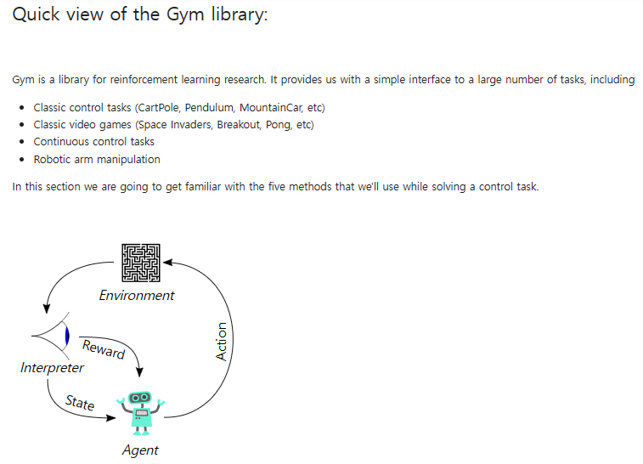
Quick view of the Gym library

Slide 5
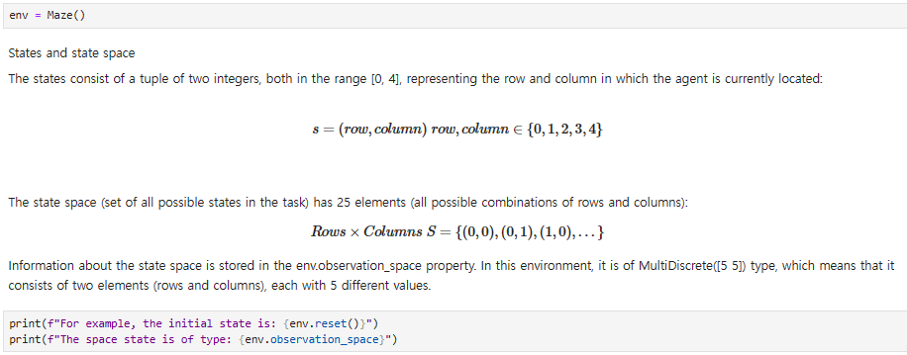
Maze env.: Find the exit
States and state space

Slide 6
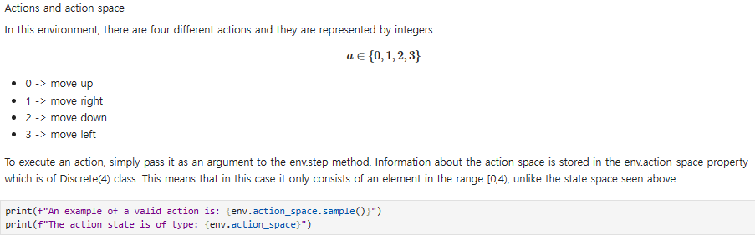
Action space

Slide 7
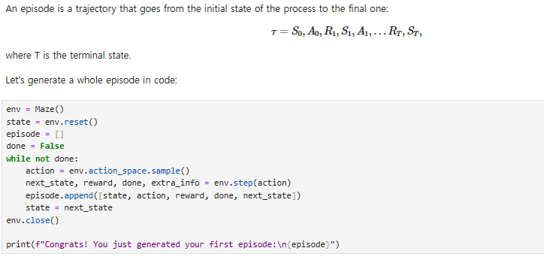
Trajectories and episodes

Slide 8
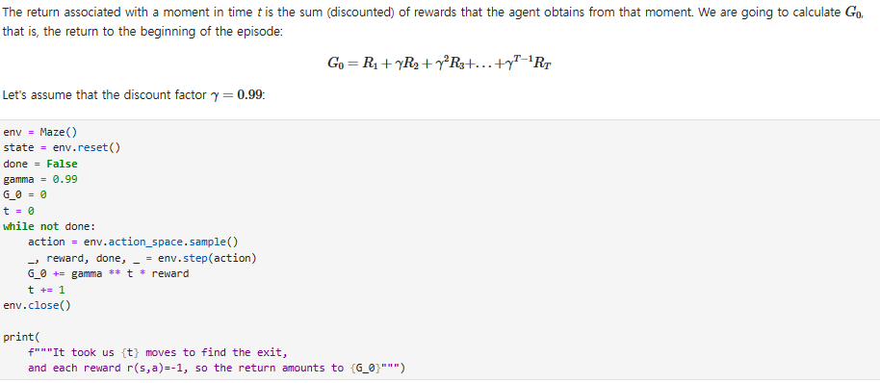
Rewards and returns

Slide 9
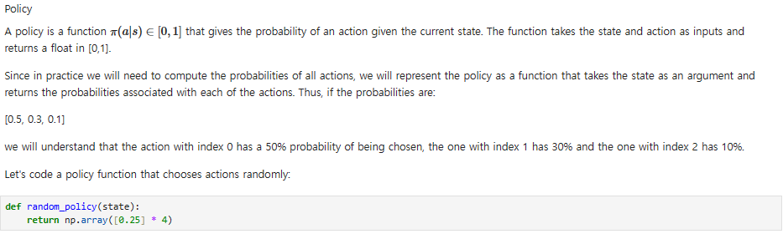
Policy

Slide 10
Dynamic Programming

Slide 11
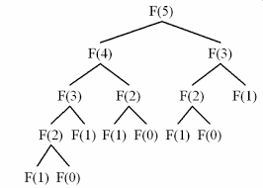
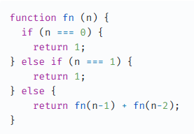
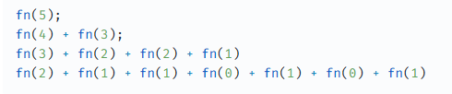
Definition
Methods that find the solution to a problem by breaking it down into smaller, easier problems.
Remember Fibonacci sequence problem from your CS class
Base case
The recursive relationship

Slide 12
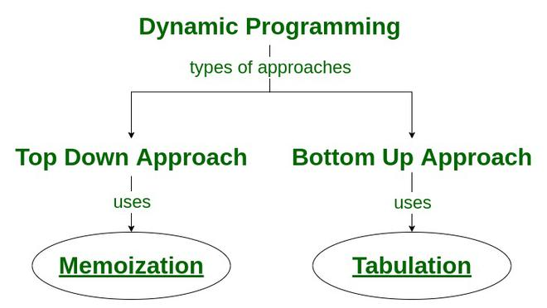
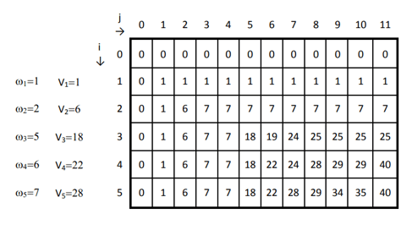
Memoization

Slide 13




Optimal substructure
In finding the solution to each of its subproblems and joining those individual solutions, we’ll have found the optimal solution to the original problem
P*
$π$*
A*
B*
C*
$π$*(s1)
$π$*(s2)
$π$*(s3)

Slide 14
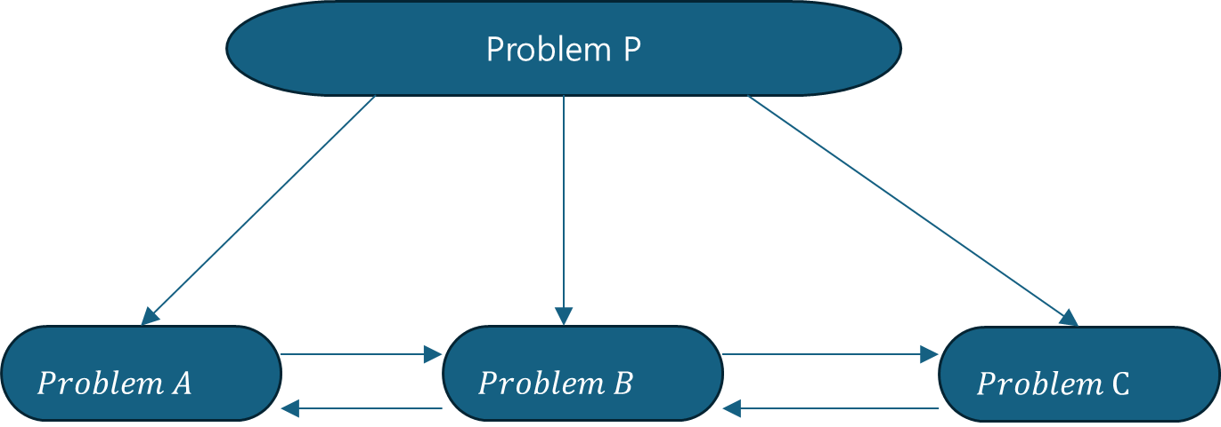
Overlapping subproblems
The solution to the subproblems are mutually dependent
The optimal solution to the problem A will be dependent on problem B and the problem B will be dependent on both problem A and problem C
The optimal solution to all subproblems produces the optimal solution to the original problem

Slide 15
Find v*, q*,

Slide 16

Our task: Find $π∗$
We can guide and structure the search for the policy using value functions
The optimal policy takes actions based on state or q-values
Therefore, to find the optimal policy, we need to find the optimal values

Slide 17
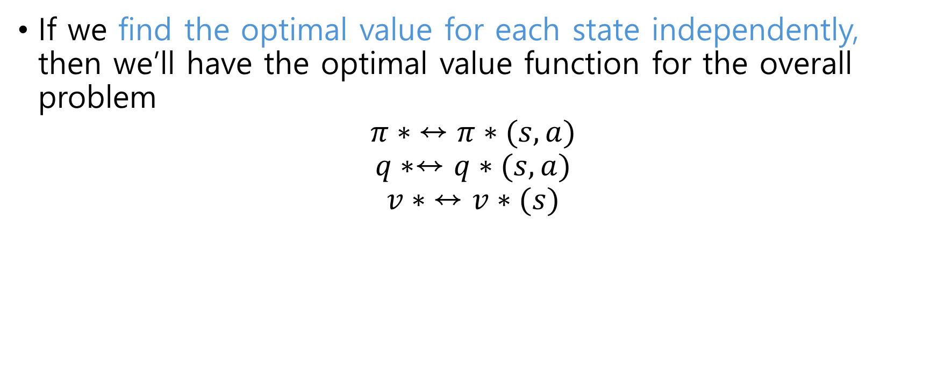
Our task: Find $π∗$
If we find the optimal value for each state independently, then we’ll have the optimal value function for the overall problem
$$π∗ ↔π∗(s,a)$$
$$q∗↔q∗(s,a)$$
$$v∗ ↔v∗(s)$$

Slide 18
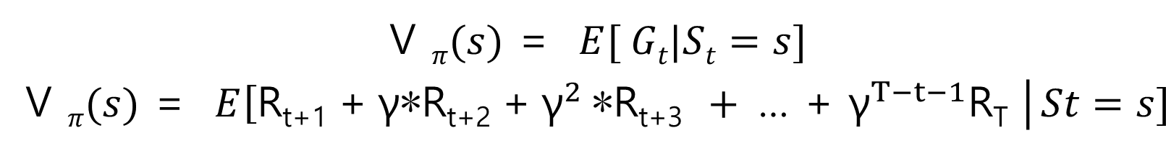

State value function(v)
State value, following policy $π$:

Slide 19
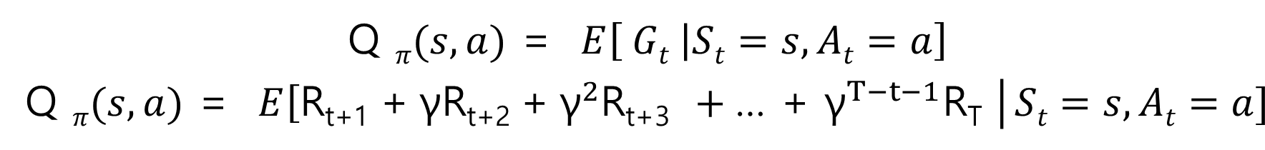

State-action value function(q)
State-action value, following policy $π$:

Slide 20
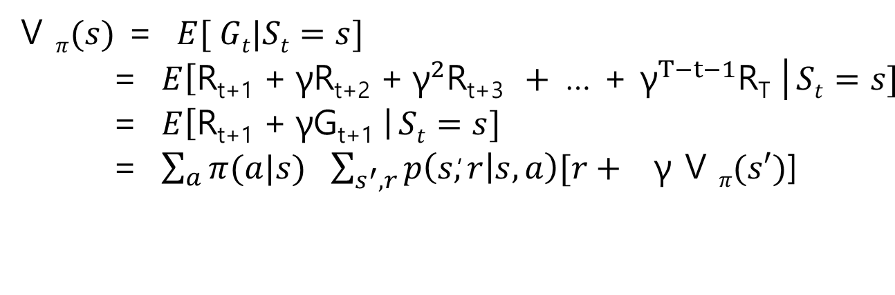
Bellman Equation for v(s)
Bellman Eq. to search for optimal policy to solve a control task
Expected return is, the prob. of taking each action following the policy, multiplied by the return we expect to get from taking that action.
The return is, the prob. of reaching each possible successor state, multiplied by the reward obtained upon reaching that state, plus the discounted value of that state
Notice we discovered a recursive relationship btw. The value of one state and the values of other states

Slide 21
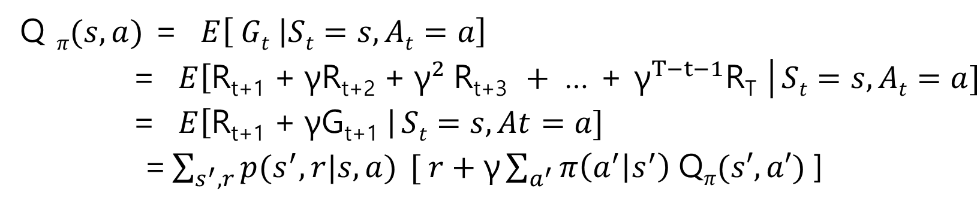
Bellman Equation for q(s, a)
Bellman Eq. to search for optimal policy to solve a control task
Multiplied by ①the reward obtained upon reaching that successor state, ②plus the discounted sum of q values of each action in the successor state, ③weighted the prob. of choosing that action by the policy
Expected return is the prob. of each successor state, knowing that we have chosen action a.
Recursive relationship is expressed as Q value in terms of other Q values

Slide 22
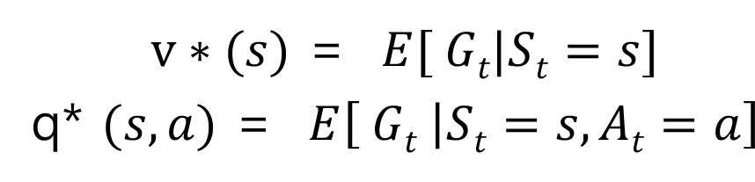
Solving a MDP
The value of a state is precisely the expected return
Solving a control task consists of maximizing the expected return
Solving a task involves maximizing the value of every state
The optimal value of a state is the expected return following the optimal policy:

Slide 23
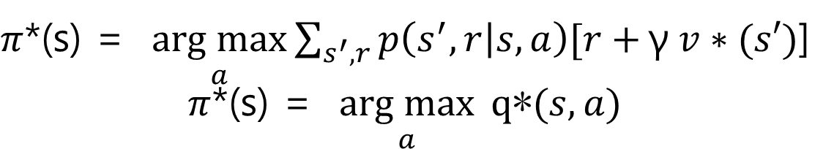
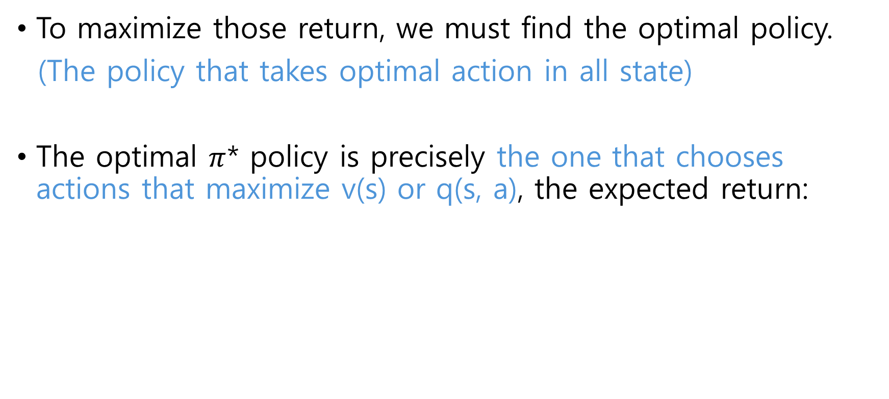
Solving a MDP
To maximize those return, we must find the optimal policy.
(The policy that takes optimal action in all state)
The optimal $π$* policy is precisely the one that chooses actions that maximize v(s) or q(s, a), the expected return:

Slide 24
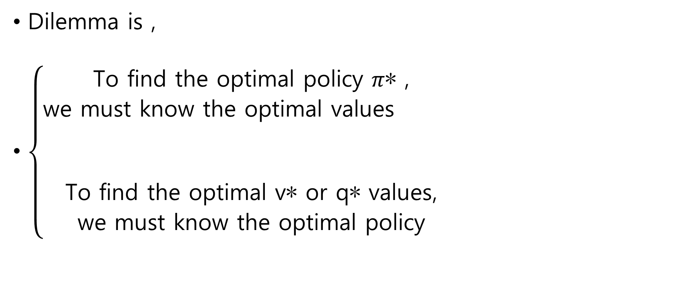
Solving a MDP
Dilemma is ,
$\left\{\begin{aligned}\text{To} \text{find} \text{the} \text{optimal} \text{policy} π\text{∗ }\text{, } \\ \text{we} \text{must} \text{know} \text{the} \text{optimal} \text{values} \\ \\ \\ \text{To} \text{find} \text{the} \text{optimal} \text{v}\text{∗ }\text{or} \text{q}\text{∗ }\text{values}\text{,} \\ \text{we} \text{must} \text{know} \text{the} \text{optimal} \text{policy} \end{aligned}\right.$

Slide 25
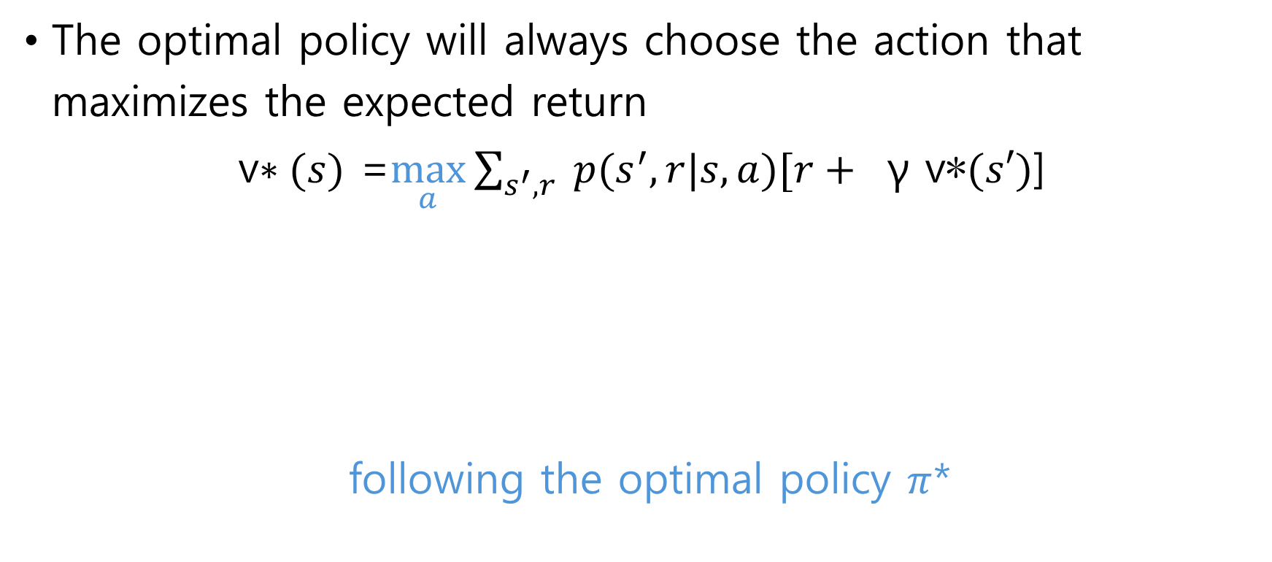
Bellman Optimality Equations
The optimal policy will always choose the action that maximizes the expected return
v$∗(s)$ =$\max_{a}{\sum_{s^{′},r}{ p(s^{′},r|s,a)[r+ } \text{γ} \text{v}\text{∗}(s′)\text{]}}$
following the optimal policy $π$*
The prob. of reaching each successor state by taking the optimal action,
multiplied by the reward achieved by reaching that state, plus the discounted optimal value of that state

Slide 26
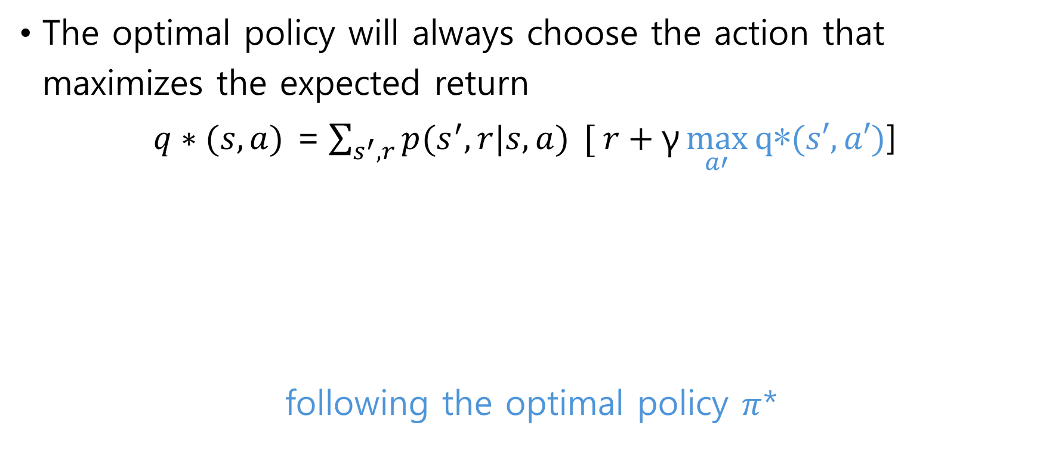
Bellman Optimality Equations
The optimal policy will always choose the action that maximizes the expected return
$q∗(s,a)$ =$\sum_{s^{′},r}{p(s^{′},r|s,a) }[ r+\text{γ}\max_{a′}{\text{q}\text{∗}(s′, a′)}$]
following the optimal policy $π$*
Optimal Q value for an action in a state is the weighted sum of returns
obtained by reaching each of possible successor state, weighted by the prob. of reaching that successor state.
The return is reward achieved upon reaching the successor state, plus the maximum Q value among the actions for that achieved state

Slide 27
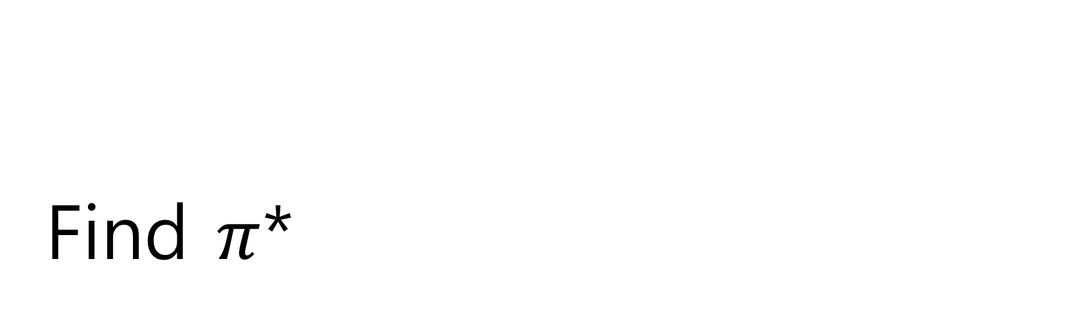
Find $π$*

Slide 28

Update Rules
DP turns Bellman equations into update rules
V$∗(s)$ =$\max_{a}{\sum_{s^{′},r}{ p(s^{′},r|s,a)[r+ } \text{γ} \text{V}\text{∗}(s′)\text{]}}$
V$(s)$ ← $\max_{a}{\sum_{s^{′},r}{ p(s^{′},r|s,a)[r+ } \text{γ} \text{V}\text{∗}(s′)\text{]}}$

Slide 29
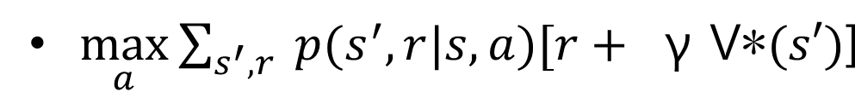
Update Rules
Sweep the state space and update the estimated value of each state according to:
Each time we update the estimated value of a state, we’ll have better estimates for the related values, therefore, the new estimate will be more accurate than the old one

Slide 30
Value Iteration

Slide 31

Value Iteration
We want to find the optimal policy $π$*(s) :
$π$*(s) = $\underset{a}{arg max}{\sum_{s^{′}, r}{p\left(s^{′},r | s,a\right)[r+}}\text{γ}v∗(s′)$]
…but for that we have to find v*

Slide 32
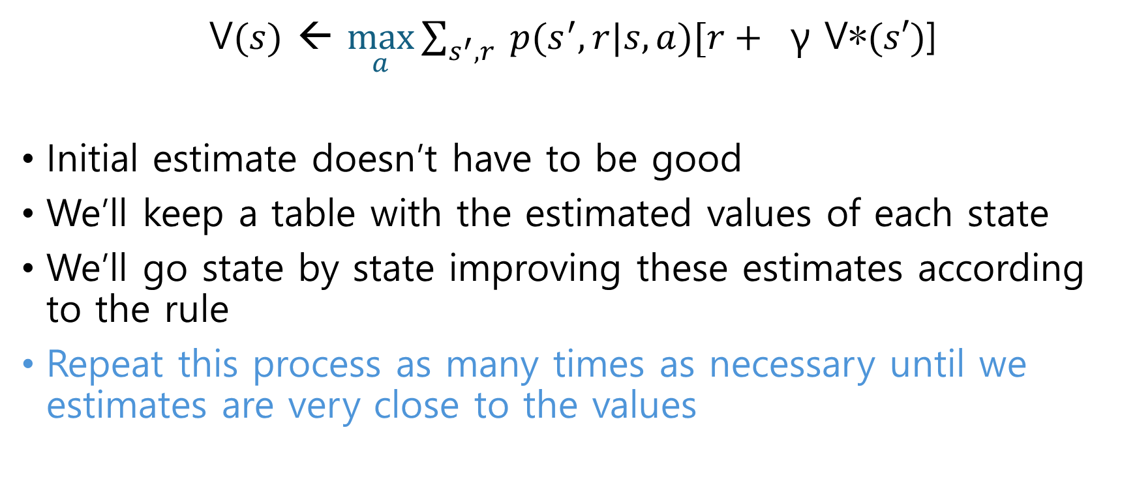
Value Iteration
V$(s)$ ← $\max_{a}{\sum_{s^{′},r}{ p(s^{′},r|s,a)[r+ } \text{γ} \text{V}\text{∗}(s′)\text{]}}$
Initial estimate doesn’t have to be good
We’ll keep a table with the estimated values of each state
We’ll go state by state improving these estimates according to the rule
Repeat this process as many times as necessary until we estimates are very close to the values

Slide 33
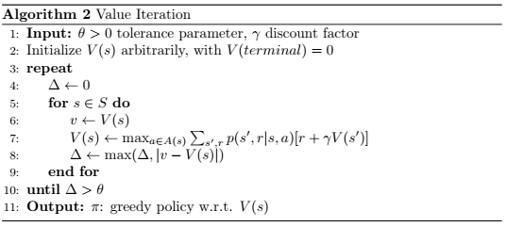

Slide 34
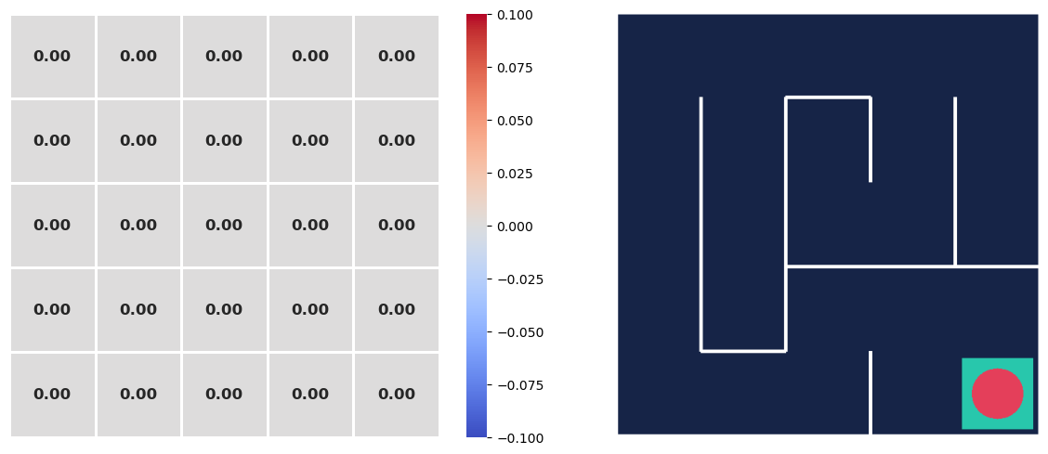
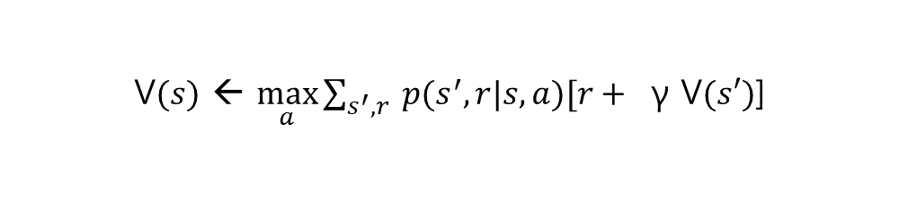
Value Iteration
t = 0
Every move, the agent gets -1. The goal is to find the shortest path.
This env. Is deterministic
V$(s)$ ← $\max_{a}{\sum_{s^{′},r}{ p(s^{′},r|s,a)[r+ } \text{γ} \text{V}(s′)\text{]}}$

Slide 35
Value Iteration
t = 1
dsd
-1.0
-1.0
-1.0
-1.0
-1.0
-1.0
-1.0
-1.0
-1.0
-1.0
-1.0
-1.0
-1.0
-1.0
-1.0
-1.0
-1.0
-1.0
-1.0
-1.0
-1.0
-1.0
-1.0
-1.0
0
V$(s)$ ← $\max_{a}{\sum_{s^{′},r}{ p(s^{′},r|s,a)[r+ } \text{γ} \text{V}(s′)\text{]}}$

Slide 36
Value Iteration
t = 2
Every move, the agent gets -1
The goal is to find the shortest path
This env. Is deterministic
dsd
-1.99
-1.99
-1.99
-1.99
-1.99
-1.99
-1.99
-1.99
-1.99
-1.99
-1.99
-1.99
-1.99
-1.99
-1.99
-1.99
-1.99
-1.99
-1.99
-1
-1.99
-1.99
-1.99
-1
0
V$(s)$ ← $\max_{a}{\sum_{s^{′},r}{ p(s^{′},r|s,a)[r+ } \text{γ} \text{V}(s′)\text{]}}$

Slide 37
Value Iteration
t = 3
dsd
-2.97
-2.97
-2.97
-2.97
-2.97
-2.97
-2.97
-2.97
-2.97
-2.97
-2.97
-2.97
-2.97
-2.97
-2.97
-2.97
-2.97
-2.97
-1.99
-1
-2.97
-2.97
-2.97
-1
0
V$(s)$ ← $\max_{a}{\sum_{s^{′},r}{ p(s^{′},r|s,a)[r+ } \text{γ} \text{V}(s′)\text{]}}$

Slide 38
Value Iteration
t = 4
dsd
-3.94
-3.94
-3.94
-3.94
-3.94
-3.94
-3.94
-3.94
-3.94
-3.94
-3.94
-3.94
-3.94
-3.94
-3.94
-3.94
-3.94
-2.97
-1.99
-1
-3.94
-3.94
-3.94
-1
0
V$(s)$ ← $\max_{a}{\sum_{s^{′},r}{ p(s^{′},r|s,a)[r+ } \text{γ} \text{V}(s′)\text{]}}$

Slide 39
Value Iteration
Found the optimal value for all state.
Note the farther a state is from the goal, the lower its value, because the agent collects negative rewards every time it moves
t = 18
The lowest one because its farthest
(17 steps to reach it)
-9.56
-10.4
-11.3
-12.2
-13.1
-8.65
-2.97
-15.7
-13.1
-13.9
-7.73
-2.97
-14.8
-13.9
-14.0
-6.79
-13.1
-2.97
-1.99
-1
-5.05
-4.90
-3.94
-1
0
V$(s)$ ← $\max_{a}{\sum_{s^{′},r}{ p(s^{′},r|s,a)[r+ } \text{γ} \text{V}(s′)\text{]}}$

Slide 40
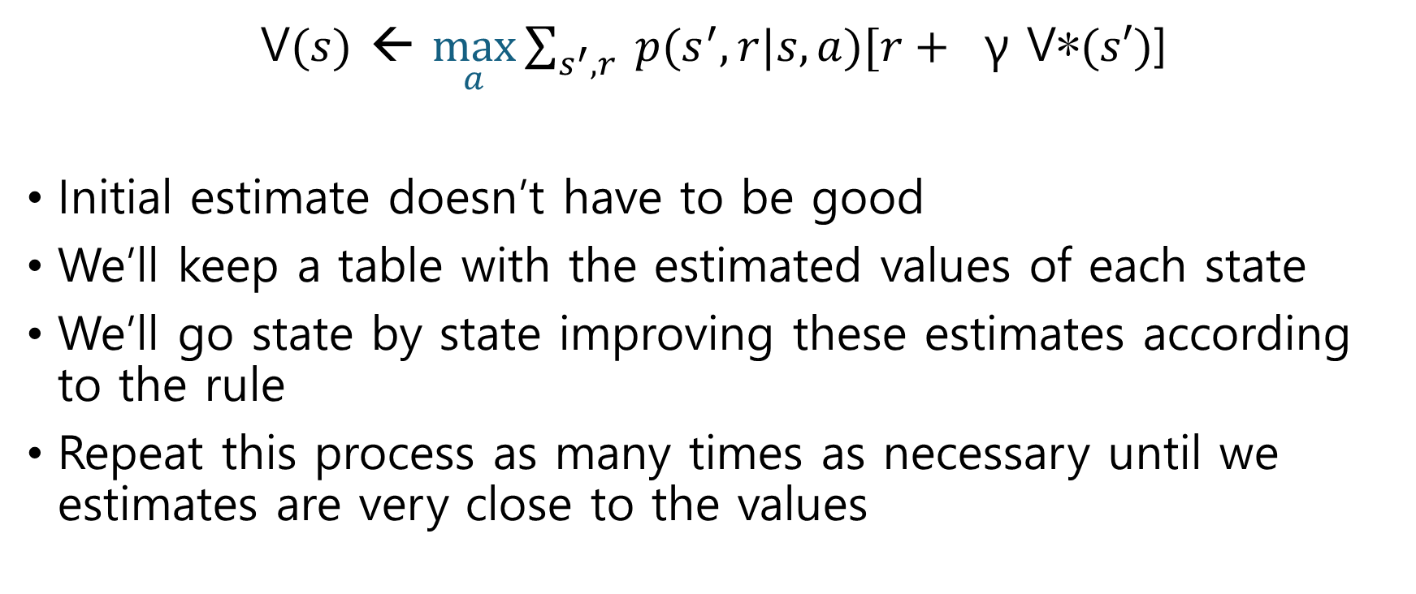
Value Iteration
V$(s)$ ← $\max_{a}{\sum_{s^{′},r}{ p(s^{′},r|s,a)[r+ } \text{γ} \text{V}\text{∗}(s′)\text{]}}$
Initial estimate doesn’t have to be good
We’ll keep a table with the estimated values of each state
We’ll go state by state improving these estimates according to the rule
Repeat this process as many times as necessary until we estimates are very close to the values

Slide 41
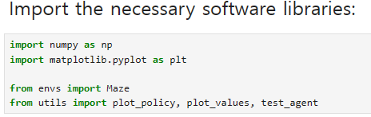
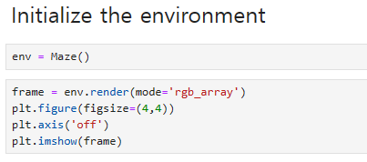
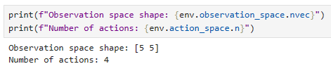
Code Exercise

Slide 42
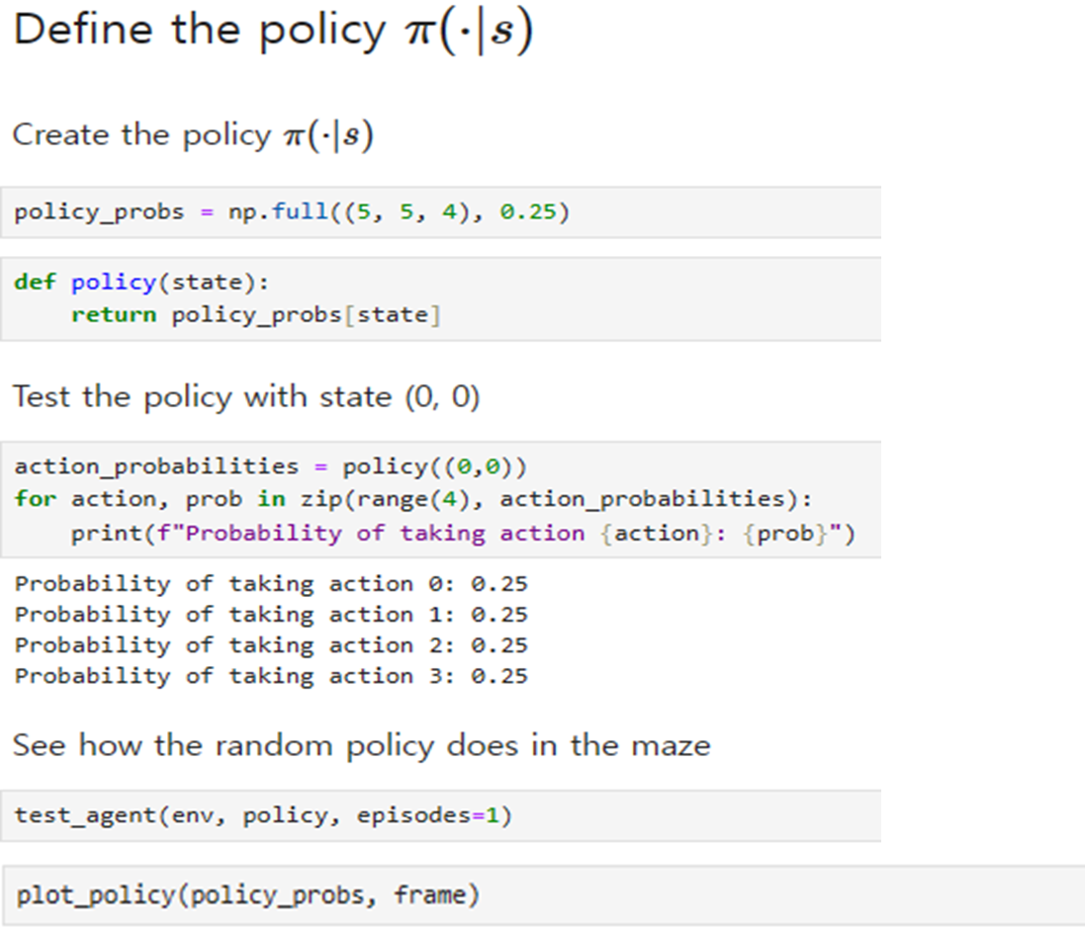
Code Exercise
See how the random policy plays in the env.

Slide 43
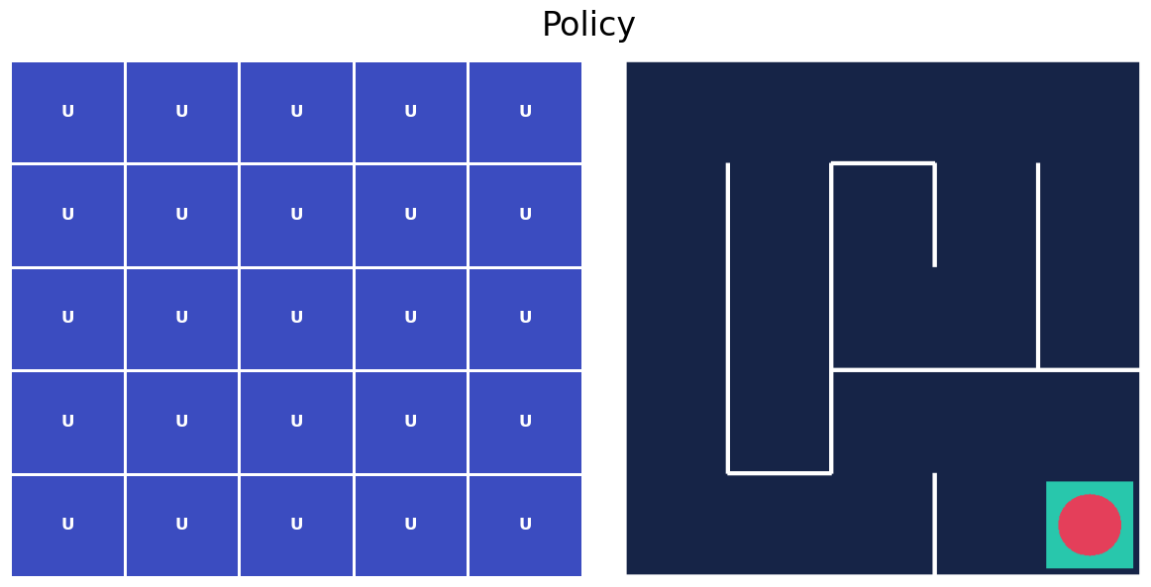
Code Exercise
Value

Slide 44
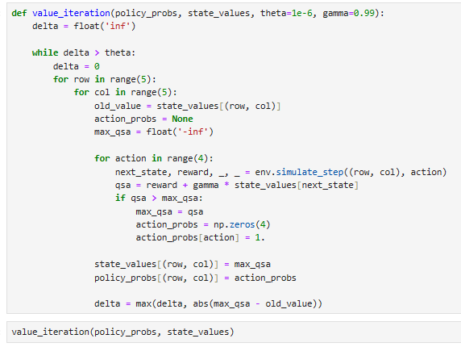
Code Exercise
Without interacting with env. Get the information about what would happen if we did
Deterministic policy (assign 100% prob. to the optimal action)
Update Policy

Slide 45
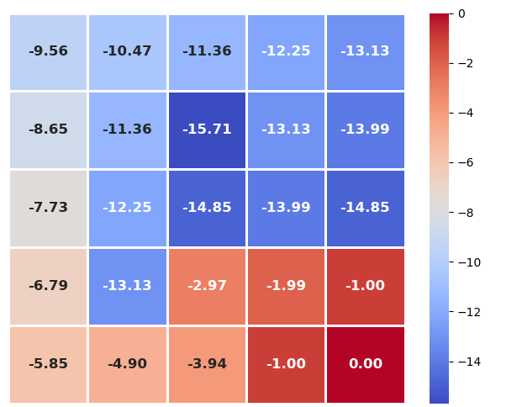
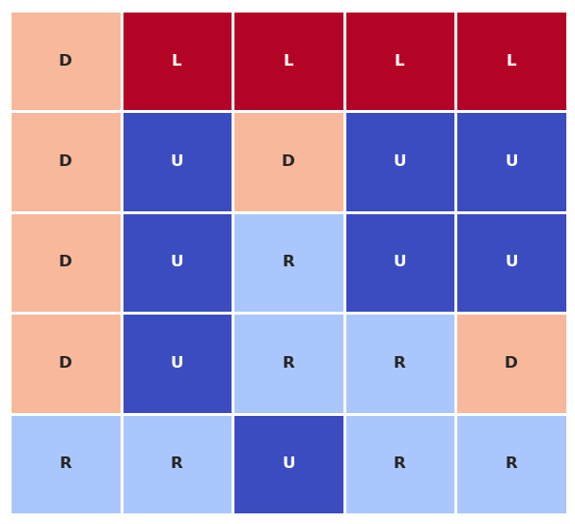
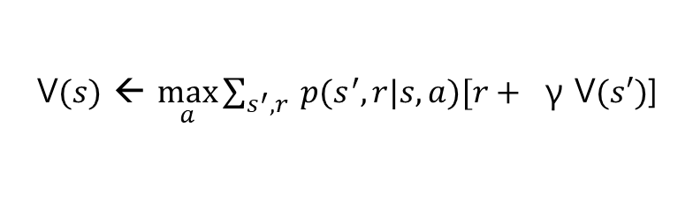
Code Exercise
V$(s)$ ← $\max_{a}{\sum_{s^{′},r}{ p(s^{′},r|s,a)[r+ } \text{γ} \text{V}(s′)\text{]}}$
Policy table
Optimal policy for all states
Value table

Slide 46
Setup Code Env.
Git clone https://github.com/parkjin-nim/rl_lecture.git
conda create -n <your env. name> -f environment.yml
Open Jupyter notebook
Open 2.DP/value_iteration.ipynb

